Slide 1
4483/8995 CAPSTONE PROJECT PRESENTATION
Titanic Survivability Prediction
Kevin Uturgaury U3246031
Wed 14:30 – 16:30 (Pranav)

Slide 2
Table of Contents
Introduction / Problem Statement
Dataset Details
EDA (Exploratory Data Analysis) Outcomes
PDA (Predictive Data Analytics) Outcomes
Implementation and Deployment (TkInter/Flask/Streamlit) Plan and Status Update
References/Bibliography

Slide 3
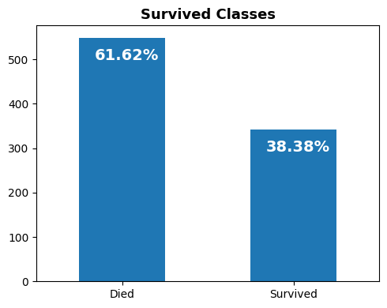
Introduction / Problem Statement
The Titanic Survivability Predication toolset was used to predict which passengers were most likely to survive on the Titanic.

Slide 4
2. Dataset Details
The dataframe/dataset used has 12 attributes with 891 observations. The dataset includes general and detailed information such as age, gender, passenger class, fare, and cabin location for each Passenger on the Titanic as well as whether or not they survived. The goal of this project was to create a model that can “predict” whether a passenger survived based on the attributes mentioned above.

Slide 5
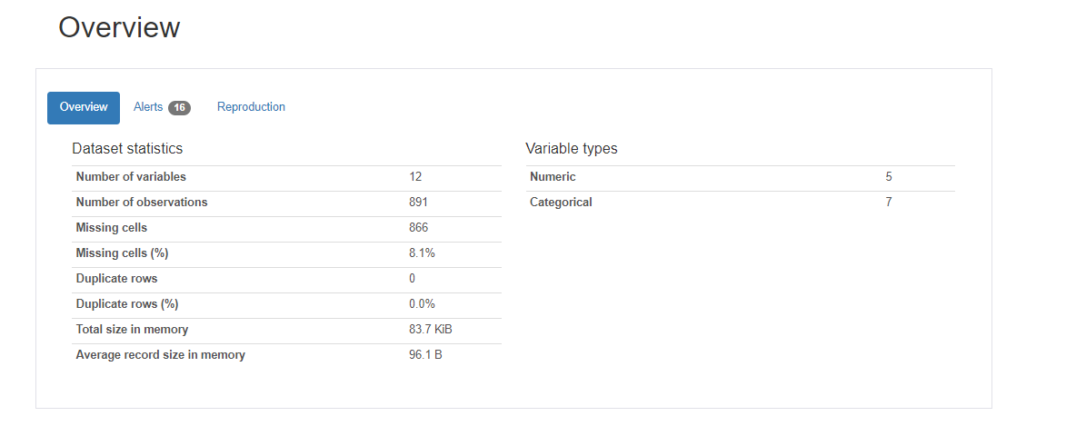
Overview

Slide 6
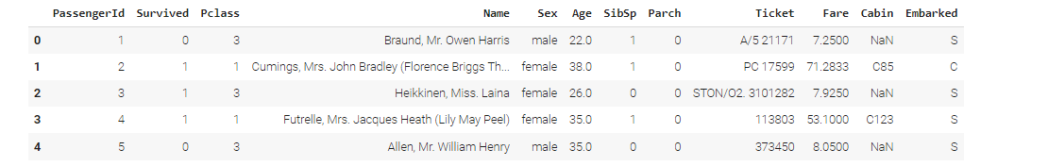
3. EDA (Exploratory Data Analysis) Outcomes
Here we are instructing the dataset to show us the first 5 rows of the data set.
Here we can see the rows and columns, columns are the attributes and the rows provide the individual data for the attributes.
df.head()

Slide 7
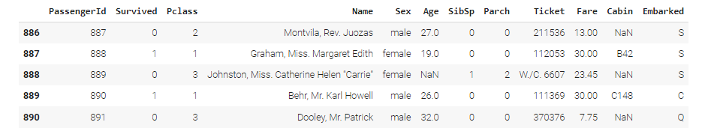
EDA cont.
Here we are instructing the dataset to show us the last 5 rows.
df.tail()

Slide 8
EDA: cont. “shape” method
The “shape” method is applied to the dataframe to show the number of rows and columns.
Rows are the observations and columns are the attributes.
df.shape
We can see there are 891 rows (observations/data) and 12 columns (attributes).

Slide 9
EDA: desribe Method
The describe() method is used to generate descriptive stats for each column in a dataframe.
“count”: refers to the number of non-missing values.
“mean”: refers to the average value of each column.
“std”: refers to the standard deviation of each column.
“min”: refers to the minimum value of each column.
“25%”: refers to the 25th percentile for each column.
“50%: refers to the 50th percentile in each column

Slide 10
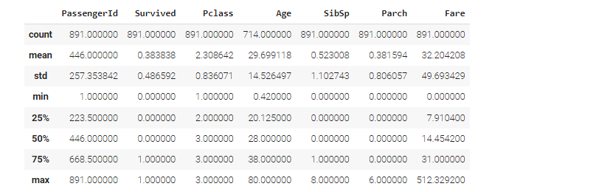
EDA: describe Method cont.
“75%”: refers to the 75th percentile in each column.
“max”: refers to the maximum value in each column.
“df.describe()”

Slide 11
EDA: Pearson Correlation
The code “df.corr(method= “pearson”)” calculates the Pearson correlation coefficient between all pairs of columns in the data frame. The Pearson correlation coefficient is a measure of the correlation between 2 variables, it ranges from -1 to 1, with “-1” indicating a negative correlation, “0” indicating no correlation and “1” indicating a positive correlation.

Slide 12
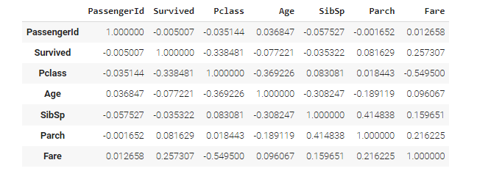
EDA: Pearson Correlation
df.corr(method = "pearson")

Slide 13
EDA: df.columns attribute
The columns attribute is used to retereive the name of the attributes/columns.
df.columns
Index(['PassengerId', 'Survived', 'Pclass', 'Name', 'Sex', 'Age', 'SibSp',
'Parch', 'Ticket', 'Fare', 'Cabin', 'Embarked'],
dtype='object')

Slide 14
EDA: df.nuniuqe method
The nunique() method is used to retrieve the names of the attributes/columns.
PassengerId 891
Survived 2
Pclass 3
Name 891
Sex 2
Age 88
SibSp 7
Parch 7
Ticket 681
Fare 248
Cabin 147
Embarked 3
dtype: int64

Slide 15
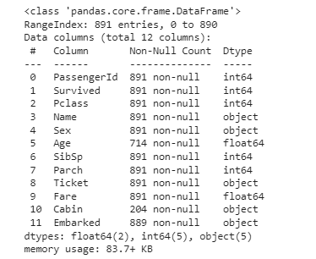
EDA: df.info() method
The info() method prints out complete information about the dataframe.
df.info()

Slide 16
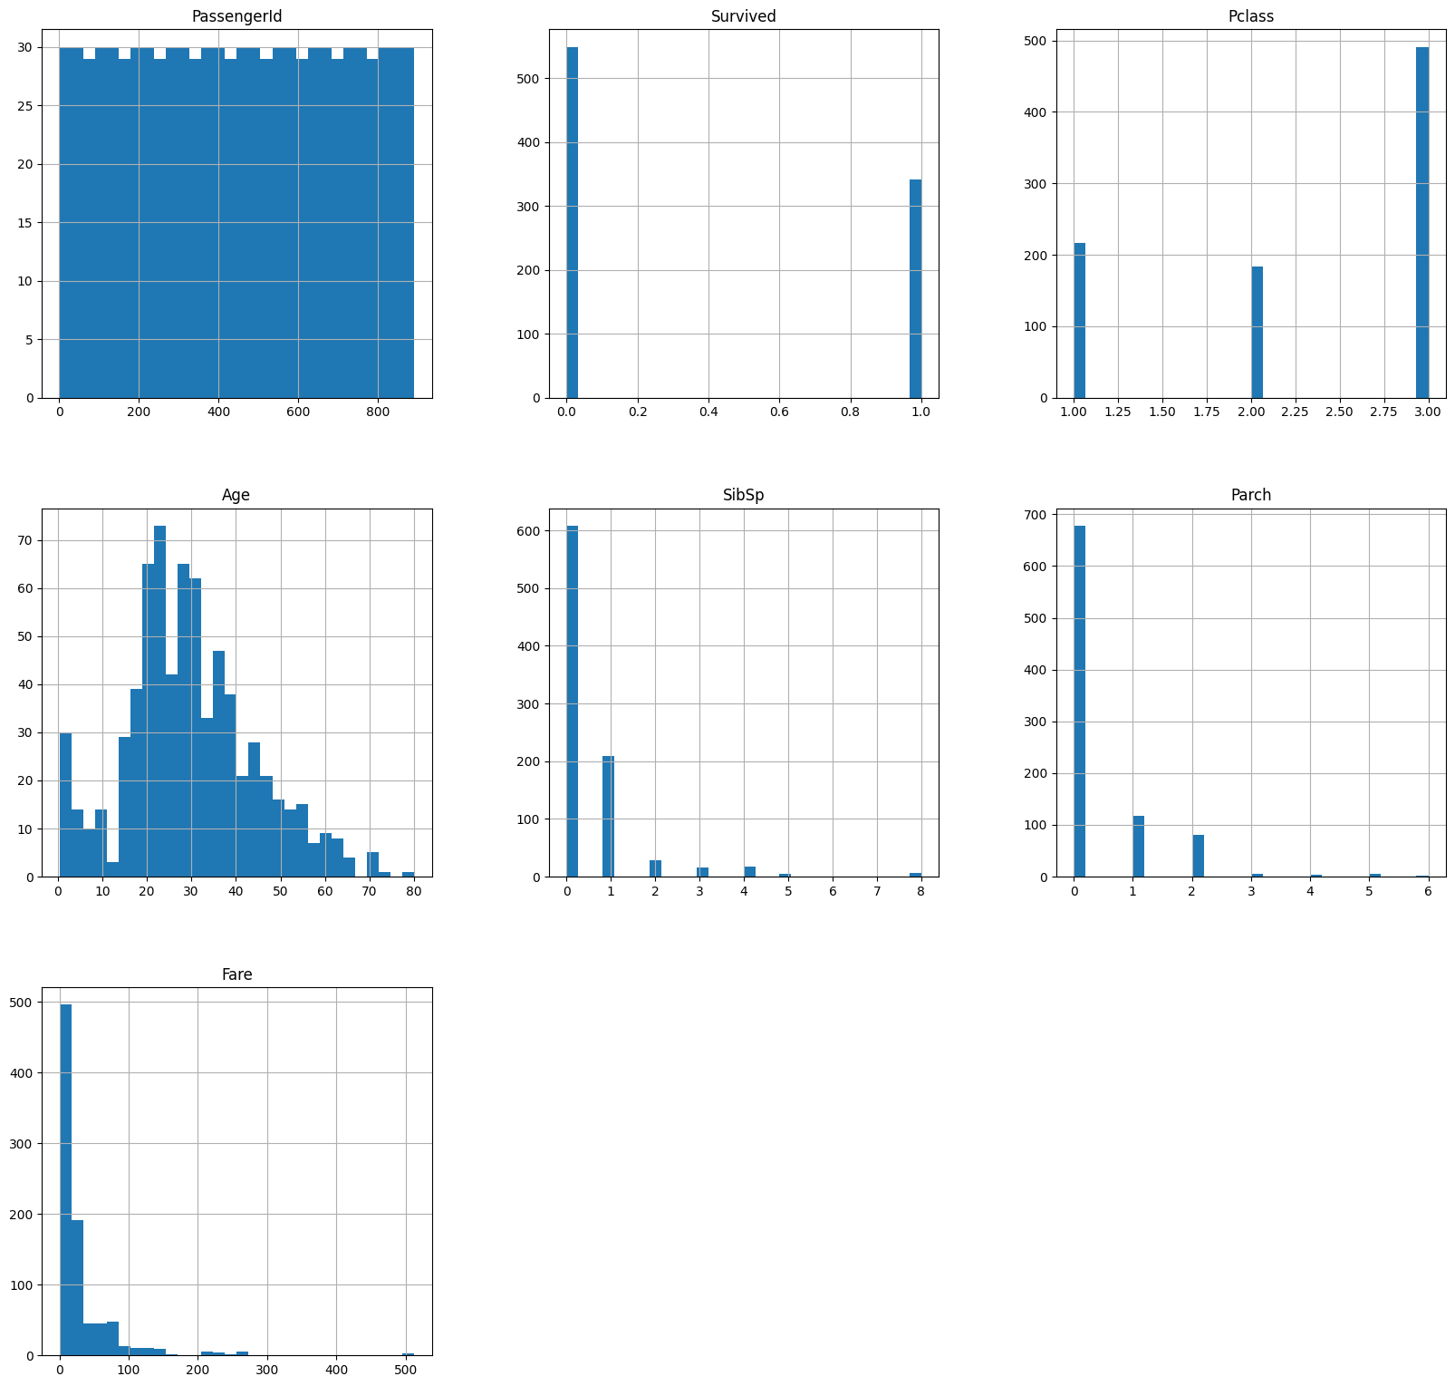
EDA: Attributes and their own Bar Graphs

Slide 17
EDA: Question 1: What are the 2 classes for the dataset? Question 2: What percentage of people survived and died?

Slide 18
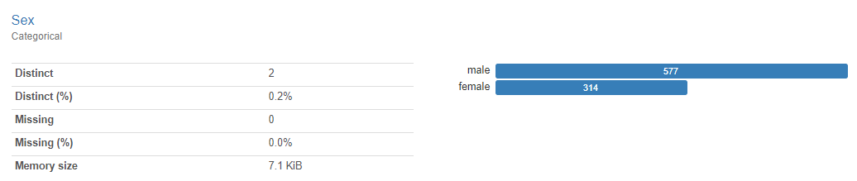
EDA: Question 3: Which sex comprised the majority of the passengers?
Males comprised the majority of the passengers aboard the Titanic.

Slide 19
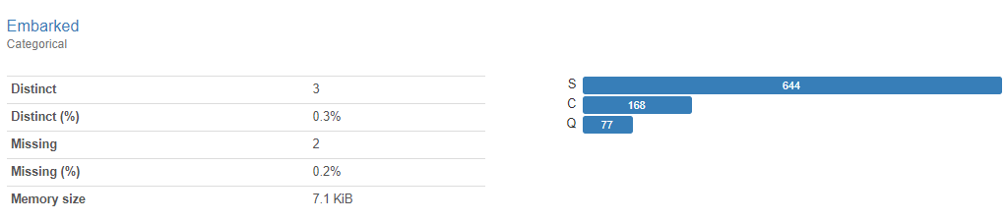
EDA: Question 4: From which port did the majority of the passengers depart?
Southampton was the port from which the majority of the passengers departed from.

Slide 20
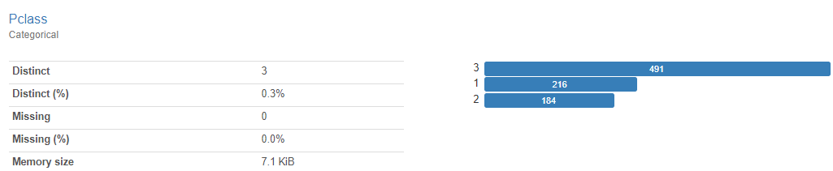
EDA: Question 5: To which Passenger Class did the majority of passengers belong to?
The majority of passengers belonged to PClass 3.

Slide 21
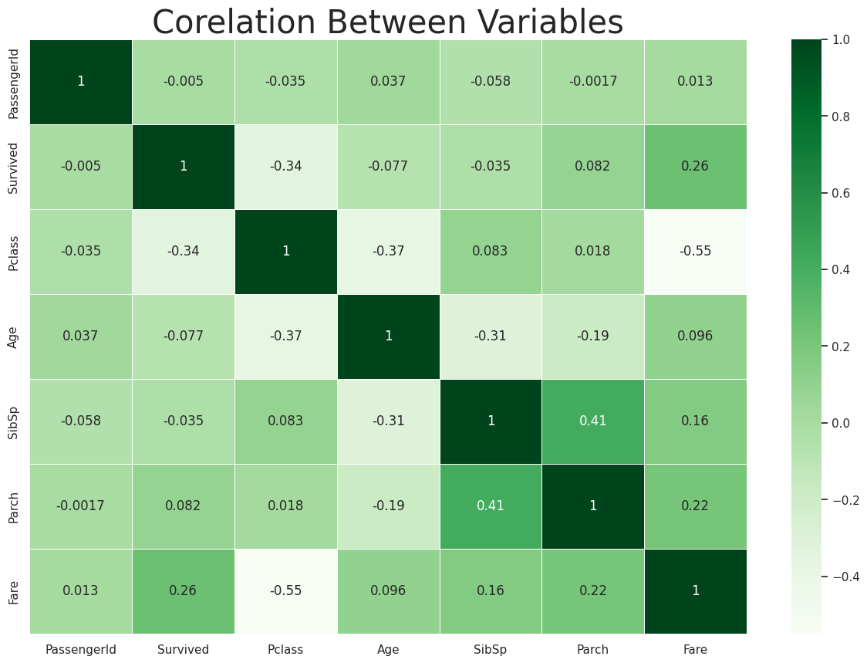
EDA: Correlation using Seaborn Heatmap

Slide 22
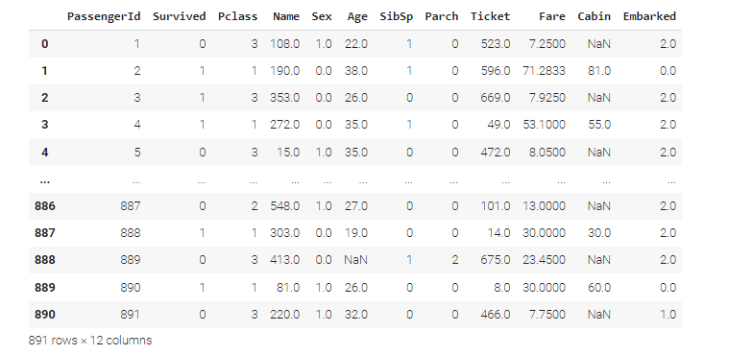
4. PDA (Predictive Data Analysis) Outcomes
We encode the object columns into integers (convert them).

Slide 23
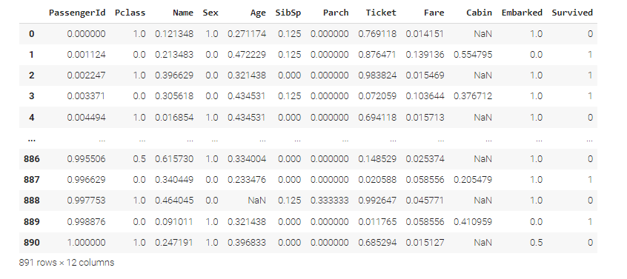
PDA: Data Normalization
The purpose of data “normalization” is to clean the data up, transforming it from its original format to a standardized format.

Slide 24
PDA: See the size of the train and test data subsets.
np.shape(x_train), np.shape(x_test)

Slide 25
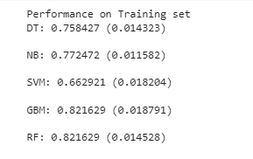
PDA: Comparing Different Analytical Models
Various models we will be using to train and test our datasets include:
DecisionTreeClassifier: “DT”
GaussianNB: “NB”
SVM: “SVC”
GradientBoostingClassifier: “GBM”
RandomForestClassifier “RF”

Slide 26
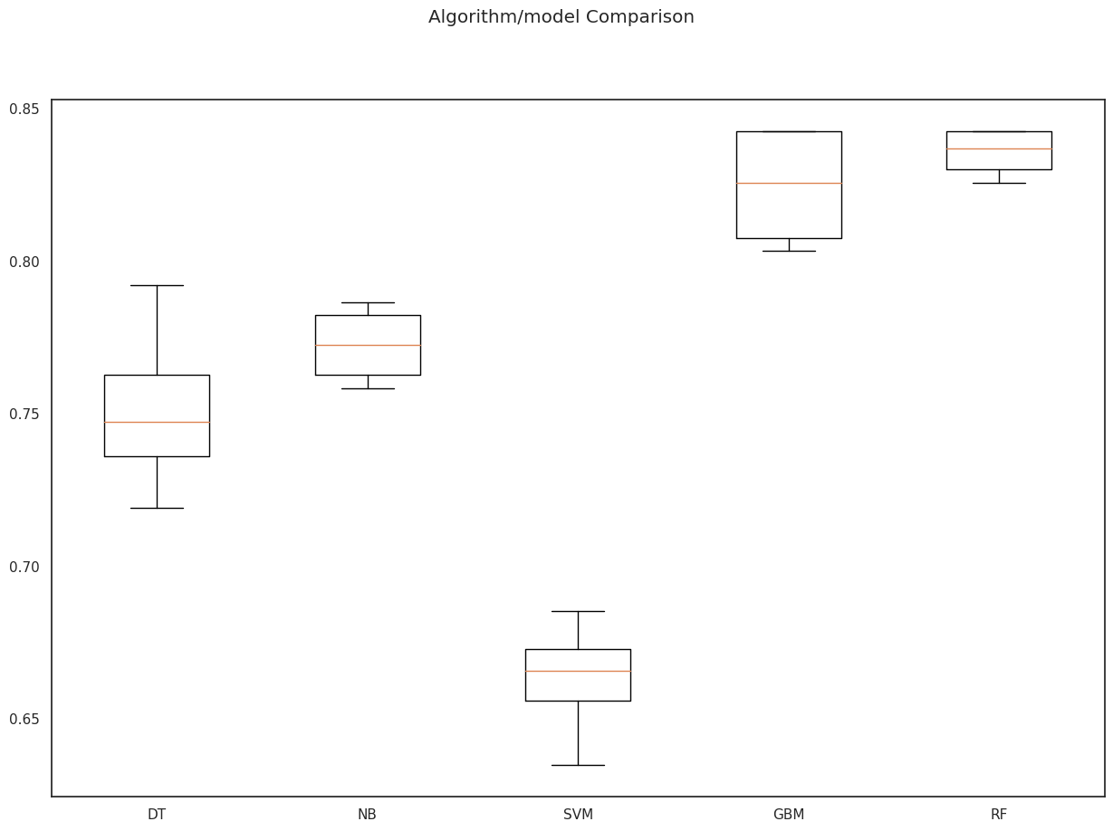
PDA: Visual Representation of the model’s performance.

Slide 27
PDA: Best Model Accuracy Score
The best model accuracy score based on the Test Set is given to GBM.

Slide 28
PDA: Model Performance Evaluation Metric 1 – Classification Report
The Classification Report is provided by the scikit-learn library and is used to evaluate the performance of a classification model by computing/calculating metrics like precision, recall, F1-score and support for each class [3]
The classification report function computes the following metrics for each class:
“Precision”: is the ratio of true positives to the sum of true positives and false positives. (It measures the accuracy of positive predictions.) [3]
“Recall”: is the ratio of true positives to the sum of true positives and false negatives. (It measures the ability of the classifier to find all the positive samples.) [3]
“F1-score”: is the mean/average of precision and recall, and provides a balanced measure of the model's performance. Closer to 1 the better the model.[3]
“Support”: is the number of samples in each class. [3]

Slide 29
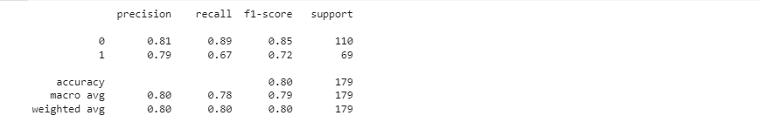
PDA: Classification Report
print(classification_report(y_test, y_pred))

Slide 30
PDA: Model Performance Evaluation Metric 2 – Confusion Matrix
What is a confusion matrix? A confusion matrix is a table that summarizes the performance of a classification algorithm by comparing the predicted labels with the actual labels of a set of “test” data [1]
The data is divided into “true positives”, “true negatives”, and “false positives”, “false negatives”

Slide 31
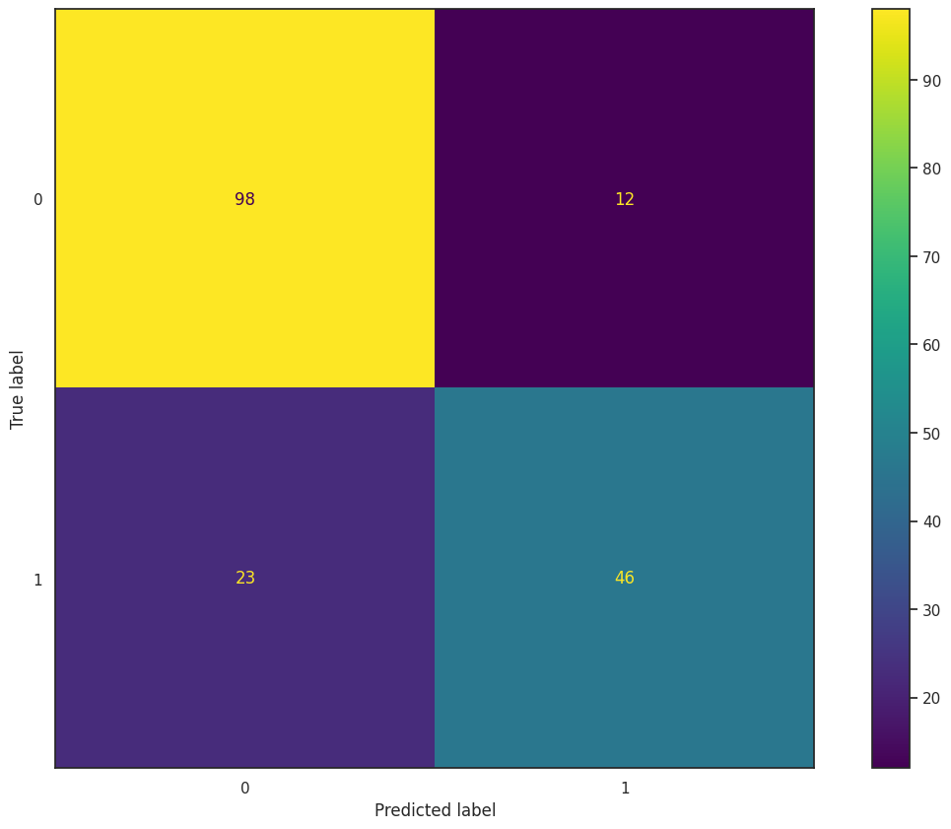
PDA: Confusion Matrix

Slide 32
PDA: Model Evaluation Metric 3 – ROC-AUC Curve
ROC: Receiver Operating Characteristic
AUC: Area Under Curve AN ROC-AUC measures the performance of a classification model by plotting the rate of true positives against false positives. The x-axis represents the false positive rate (FPR), and the y-axis represents the true positive rate (TPR). The dotted line represents the ROC curve of a random classifier [2]
The ROC-AUC curve visually shows us how well our model is performing at different classification thresholds. The closer the curve is to the top left corner of the plot, the better the model's performance.

Slide 33
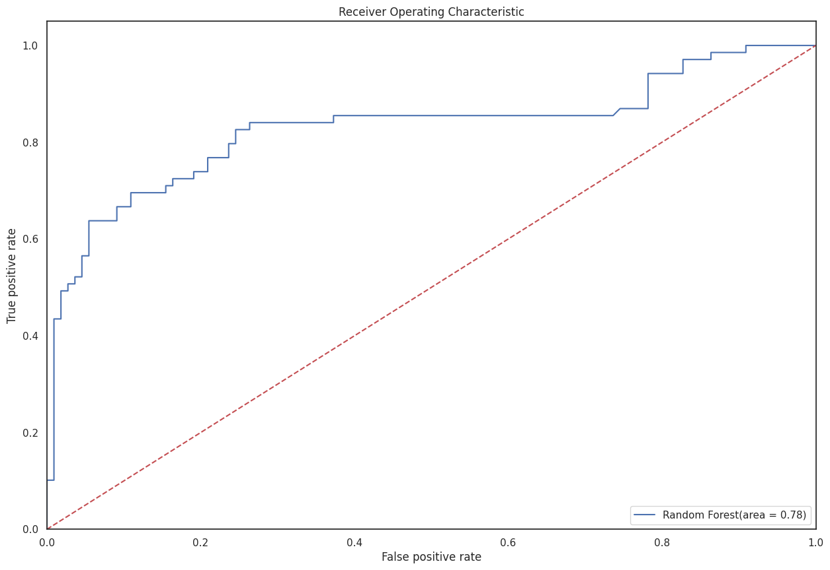
PDA: ROC-AUC Curve

Slide 34
PDA: Model Evaluation Metric 4 – Prediction Report
The prediction report allows a person to visually compare the predicted and actual lables for each data point in the test subset of data. This helps to evaluate the performance of your models and understand where it may be making errors.

Slide 35
PDA: Model Evaluation Metric 4 – Prediction Report
Predicted: 0 Actual: 0 Data: (725, 2, 617, 1, 25, 0, 0, 266, 54, 147, 2)
Predicted: 0 Actual: 0 Data: (861, 1, 283, 1, 27, 1, 0, 221, 76, 147, 2)
Predicted: 0 Actual: 0 Data: (528, 2, 725, 1, 52, 0, 0, 250, 41, 147, 2)
Predicted: 0 Actual: 0 Data: (46, 2, 473, 1, 88, 1, 0, 462, 102, 147, 1)
Predicted: 1 Actual: 1 Data: (627, 0, 490, 0, 27, 0, 0, 71, 213, 114, 2)
Predicted: 1 Actual: 0 Data: (357, 1, 270, 0, 51, 0, 0, 131, 85, 147, 2)
Predicted: 0 Actual: 0 Data: (890, 2, 220, 1, 42, 0, 0, 466, 30, 147, 1)
Predicted: 0 Actual: 0 Data: (179, 2, 474, 1, 48, 0, 0, 574, 0, 147, 2)
Predicted: 0 Actual: 0 Data: (562, 1, 593, 1, 36, 0, 0, 103, 87, 147, 2)
Predicted: 1 Actual: 1 Data: (879, 0, 668, 0, 72, 0, 1, 59, 221, 70, 0)
Predicted: 1 Actual: 1 Data: (53, 1, 246, 0, 38, 1, 0, 239, 138, 147, 2)
Predicted: 0 Actual: 0 Data: (159, 2, 716, 1, 88, 6, 2, 568, 205, 147, 2)
Predicted: 1 Actual: 1 Data: (98, 1, 219, 0, 45, 0, 1, 117, 129, 147, 2)
Predicted: 1 Actual: 1 Data: (237, 1, 172, 0, 12, 0, 2, 556, 139, 147, 2)

Slide 36

5. Implementation and Deployment (TkInter) Plan and Status Update
I deployed the Best Model as a Tkinter GUI app to be used to predict whether or not the person would survive aboard the Titanic.

Slide 37
References /Bibilography
https://www.facebook.com/jason.brownlee.39, “What is a Confusion Matrix in Machine Learning,” Machine Learning Mastery, May 30, 2018. [Online]. Available: https://machinelearningmastery.com/confusion-matrix-machine-learning/. [1]
Total, “ROC Curves & AUC: What Are ROC Curves | Built In,” builtin.com, May 02, 2023. [Online]. Available: https://builtin.com/data-science/roc-curves-auc [2]
Zach, “How to Interpret the Classification Report in sklearn (With Example),” Statology, May 09, 2022. [Online]. Available: https://www.statology.org/sklearn-classification-report/. [3]

